Slide 1
Electronic Instrumentation Section-1, Ppt-13

Slide 2
Electrostatic discharge (ESD)

Slide 3
Electrostatic discharge (ESD)
Electrostatic discharge (ESD) is the sudden flow of electricity between two electrically charged objects caused by contact, an electrical short, or dielectric breakdown.

Slide 4
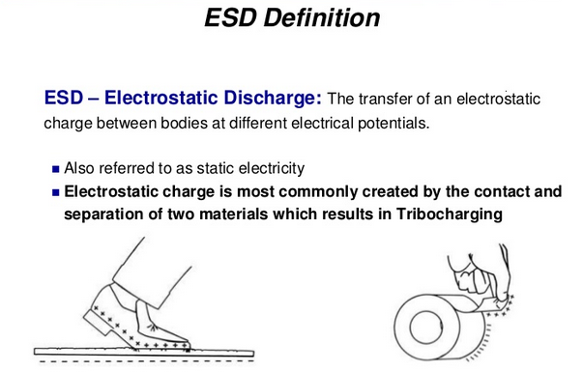

Slide 5
ESD
Sparks – A spark is triggered when the electric field strength exceeds approximately 4-30kV/cm. This may cause a very rapid increase of free electrons and ions in the air, temporarily causing the air to abruptly become an electrical conductor. eg, lightning.

Slide 6
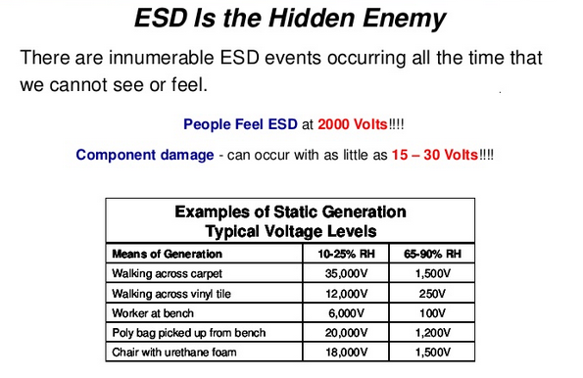

Slide 7
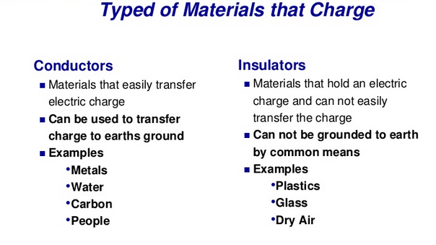

Slide 8
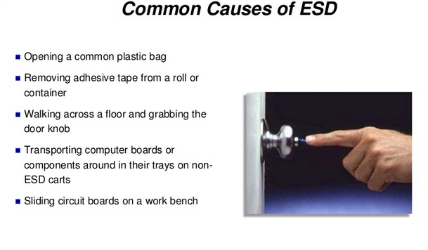

Slide 9
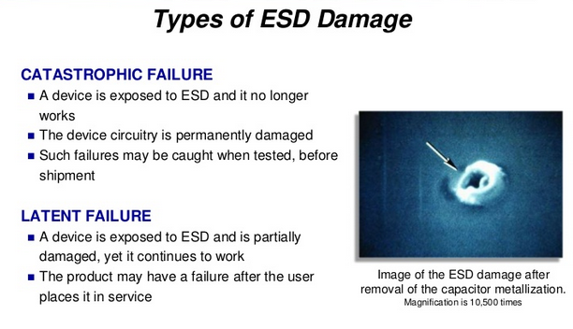

Slide 10
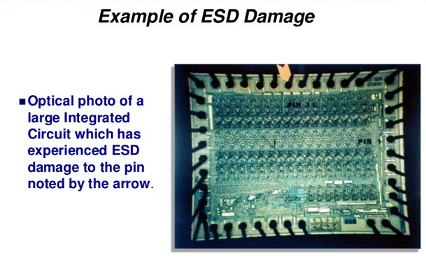

Slide 11
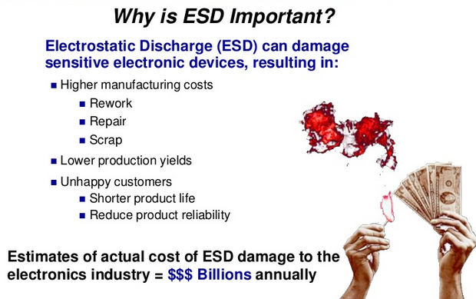

Slide 12
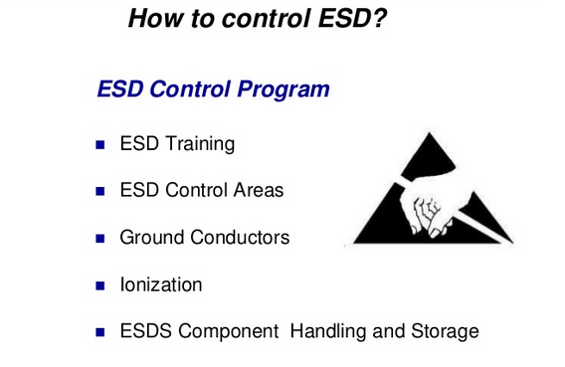

Slide 13
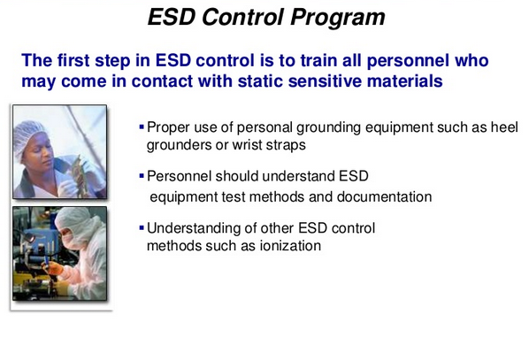

Slide 14
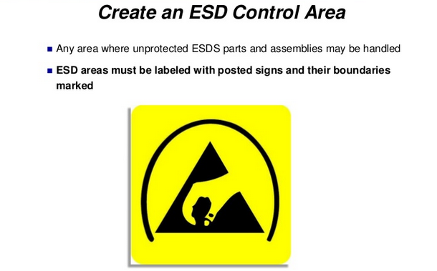

Slide 15
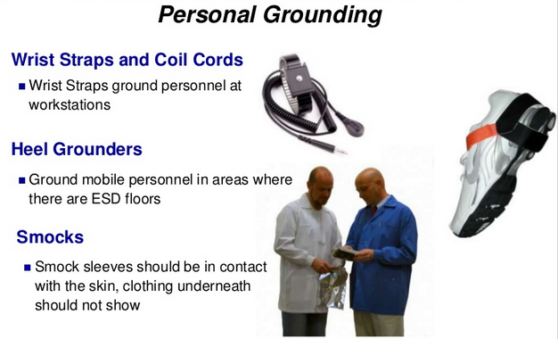

Slide 16
ESD Simulations
There are three models for assessing the survivability/susceptibility of electronic devices to ESD:
1)Human Body Model, HBM
2)Machine Model, MM
3)Charged Device Model, CDM

Slide 17
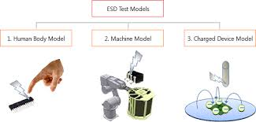

Slide 18
The human-body model (HBM) is the most commonly used model for characterizing the susceptibility of an electronic device to damage from electrostatic discharge (ESD)
The model is a simulation of the discharge which might occur when a human touches an electronic device.

Slide 19
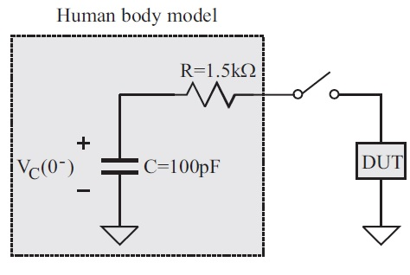
Human Body Model
HBM (Human Body Model) test circuit simulates ESD from human contact and consists of 100pF and 1.5KΩ to simulate the equivalent capacitance and resistance of a human body.
The capacitor is charged to a predetermined high voltage from an external source, and then suddenly discharged through the resistor into an electrical terminal of the device under test (DUT)

Slide 20
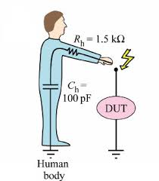
Human Body Model
Simulates ESD from human contact.
A person accumulates static electricity from walking or moving and discharges the static through the IC. The leads become the conductive path to a grounded surface due to contact

Slide 21
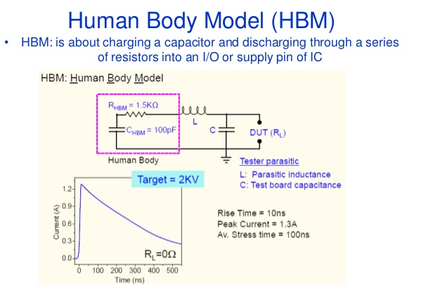

Slide 22
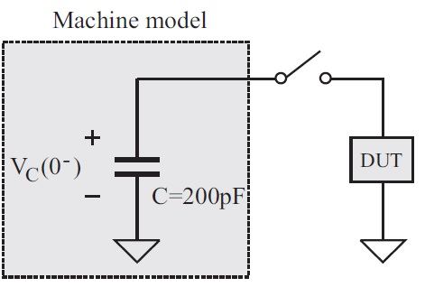
Machine Model
Machine Model - MM This simulates the discharge of static electricity accumulated from machines and equipment (i.e. moving mechanical arms, test probes, etc.).
The test circuit consists of charging a 200pF capacitor to a predetermined high voltage from an external source, and then suddenly discharging the DUT through an electrical terminal.

Slide 23
Charged Device Model – CDM
The CDM test simulates how the device acts when the device itself has an electrostatic charge and the effects of the discharge when it comes in contact with a metallic surface.
This type of discharge is the most common type of ESD in electronic devices and is the main cause of ESD damage during the manufacturing process.
CDM discharge depends mainly on parasitic parameters of the discharge and is strongly dependent on the size and type of component package.

Slide 24
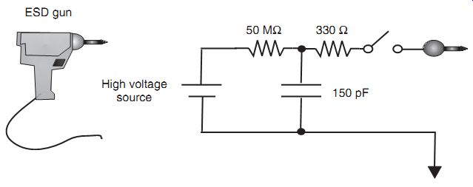
Simulates ESD in a charged device at 150pF and 330Ω. The capacitor is charged to a specific high voltage from an external source, and then suddenly discharged through the resistor into an electrical terminal of the device under test (DUT).

